Slide 1
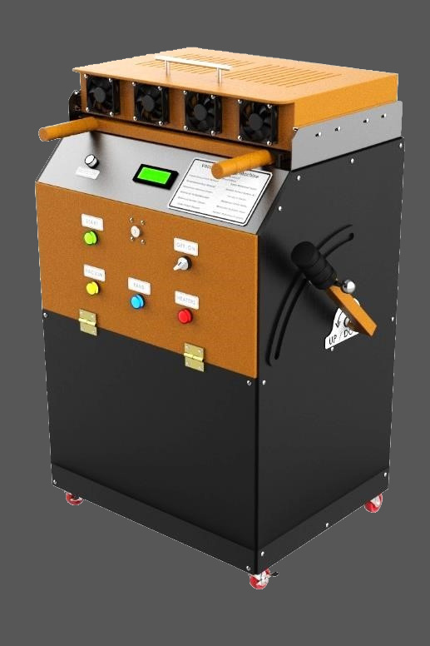

PROJECT 2
DESIGN & MANUFACTURING OF
MANUAL VACUUM FORMING MACHINE
Under the supervision of
Dr. Mahmoud Mohamed Saafan

Slide 2
WHAT IS IT ?
VACUUM FORMING MACHINE
Vacuum forming is a manufacturing method used to shape plastic materials. During the vacuum forming process, a sheet of plastic is heated and then pulled around a single mold using suction.
Vacuum forming is used for a wide range of manufacturing applications, ranging from small custom parts produced on desktop devices to large parts manufactured on automated industrial machinery.

Slide 3
VACUUM FORMING MACHINE
DISCUSSION FLOW
Mechanical Portion
Hardware Portion
Software Portion
Applications

Slide 4
Mechanical Portion
MEET THE TEAM
HASAN MOHAMED HASAN
MOHAMMED FARIED EL-SOFANY
IBRAHIM HAMED IBRAHIM ALI
KARIM KHALED ELSAYED

Slide 5
Mechanical Portion

Slide 6
VACUUM FORMING MACHINE
DISCUSSION FLOW
Mechanical Portion
Hardware Portion
Software Portion
Applications

Slide 7
Hardware Portion
MEET THE TEAM
ABDELRAHMAN MAMDOUH IBRAHIM
HOSSAM AHMED ABD EL-MAKSOUD
AMR USRY EL-SHERBINY
MOHAMED ABDALLAH HASSAN

Slide 8
Hardware Portion

Slide 9
VACUUM FORMING MACHINE
DISCUSSION FLOW
Mechanical Portion
Hardware Portion
Software Portion
Applications

Slide 10
Software Portion
MEET THE TEAM
ABDELRAHMAN NASR MAAROOF
MAHMOUD ALI ABDALMONEM
MAHMOUD IBRAHIM OSMAN

Slide 11
Software Portion

Slide 12
VACUUM FORMING MACHINE
DISCUSSION FLOW
Mechanical Portion
Hardware Portion
Software Portion
Applications

Slide 13
Applications

Slide 14
VACUUM FORMING MACHINE
DISCUSSION FLOW
Mechanical Portion
Hardware Portion
Software Portion
Applications

Slide 15
THANK YOU!

